Slide 1
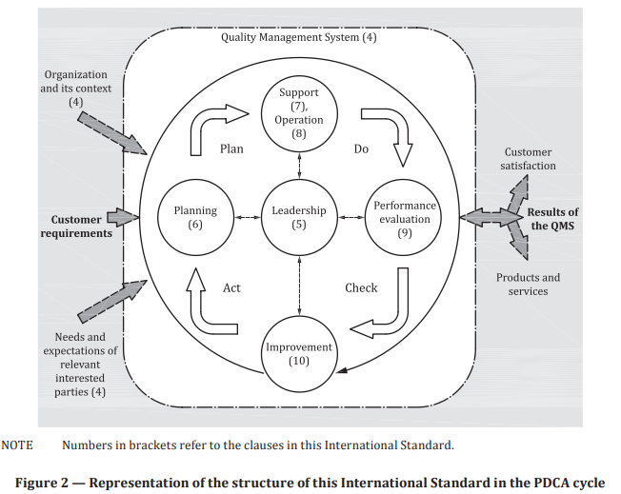
Trustable QMS
ISO 9001:2015
The trustability of the Quality Management System (QMS) is based on:
Internal management of people, tools, and processes responsible for the lifecycle of an application from conception to end of life
Open source software development lifecycle practices to generate certified open source solutions
Monitoring and enforcing interactions with external partners
Leadership (i.e., “influence more than a job title”)
‹#›
The next slide introduces the QMS schematic representation derived from ISO 9001:2015 Figure 2.

Slide 2
Trustable QMS
Legend
Quality Management Areas
Input / Output of the process
QMS schematic representation
Community*
People/team
Compliance
Stakeholder
Coding
Planning
Releasing
Deployment
Stakeholder
Risk
CI
CD
SW artifacts
SW artifacts
Building
Operation
Testing
Monitor
Lifecycle model
Project
Quality Engineering
‹#›

Slide 3
Trustable QMS
Relevant aspects of the QMS
QM Area | Aspects
Risk* | Risk Management strategy
 | Risk Management processes
 | Business Controls & Internal Audit
Stakeholder | Stakeholder Satisfaction, Feedback (Measured metrics)
 | Interactions & Progress reporting
 | Quality control
 | Communication
Community | Involvement of organizations
Resource | …
Compliance | Processes & products evaluated against industry & government standards
 | Contribution to standards, communities, regulations & laws
QM Area | Aspects
People/team | Roles & responsibilities assignment
 | Management of the skills including training, coaching & proven competencies
 | Recording platform
 | Learning product & service
Program | Strategy
 | Project management: Backlog grooming, development / stabilization sprints
 | Problem Resolution & Process improvement
Quality Engineering | Quality engineering strategy & evidence traceability
 | Management of artifacts
 | Testing & gating strategy
 | Tooling (including metrics & reporting)
 | Release Readiness Report
‹#›
* Defined at corporate level

Slide 4
Relevant aspects of QMS
QM Area | Aspects | QM Requirements | OS Evidence
X
‹#›

